Slide 1



C﻿ORONA VIRUS ANALYSIS
Author: Aditya Satheesan
Profile: Data Analyst
Batch: MIP-DA-11

Slide 2
TABLE OF CONTENTS
01
02
PROJECT OVERVIEW
DATA DESCRIPTION
03
04
EXPLORATORY DATA ANALYSIS
INSIGHTS

Slide 3
01
PROJECT OVERVIEW

Slide 4

The Corona Virus Disease 2019 (COVID-19) is an infectious disease caused by the severe acute respiratory syndrome coronavirus 2 (SARS-CoV-2). The virus was first identified in December 2019 in Wuhan, Hubei Province, China, and has since spread globally, leading to an ongoing pandemic.
The Corona Virus pandemic has had a significant impact on public health and has created an urgent need for data-driven insights to understand the spread of the virus. This project aims at analyzing a Corona Virus dataset to derive meaningful insights and present valuable findings.

Slide 5
02
DATA DESCRIPTION

Slide 6
VARIABLE | DESCRIPTION
Province | The province or state within the country where the data is recorded.
Country/Region | The country or region where the data is recorded.
Latitude | The latitude coordinate of the location where the data is recorded.
Longitude | The longitude coordinate of the location where the data is recorded.
Date | The date when the data was recorded.
Confirmed | The number of confirmed COVID-19 cases recorded on the given date at the specified location.
Deaths | The number of deaths due to COVID-19 recorded on the given date at the specified location.
Recovered | The number of recovered COVID-19 cases recorded on the given date at the specified location.

Slide 7



This dataset provides daily records of the COVID-19 pandemic's progression across various provinces, countries, and regions worldwide. Each entry includes the geographic coordinates (latitude and longitude), the date of the record, and the counts of confirmed cases, deaths, and recoveries. This data is crucial for tracking the spread and impact of the virus over time and can be used for various analytical purposes, including trend analysis, forecasting, and resource allocation planning.

Slide 8
03
EXPLORATORY DATA ANALYSIS

Slide 9
Q1. Write a code to check NULL values
SELECT * FROM [Corona Virus Dataset]
WHERE Province IS NULL OR
Country_Region IS NULL OR
Latitude IS NULL OR
Longitude IS NULL OR
Date IS NULL OR
Confirmed IS NULL OR
Deaths IS NULL OR
Recovered IS NULL;

Slide 10

Q2. If NULL values are present, update them with zeros for all columns.
Q3. Check total number of rows
SELECT COUNT(*) AS Total_Rows
FROM [Corona Virus Dataset];
Since there are no values present, we do not need to update the columns with zeros.

Slide 11

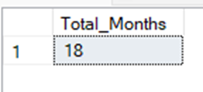
Q4. Check what is start_date and end_date
Q5. Number of month present in dataset
SELECT MIN(Date) AS Start_Date, MAX(Date) AS End_Date
FROM [Corona Virus Dataset];
SELECT COUNT(DISTINCT CONCAT(Year(Date),
' ',Month(Date)))
AS Total_Months FROM [Corona Virus Dataset];

Slide 12
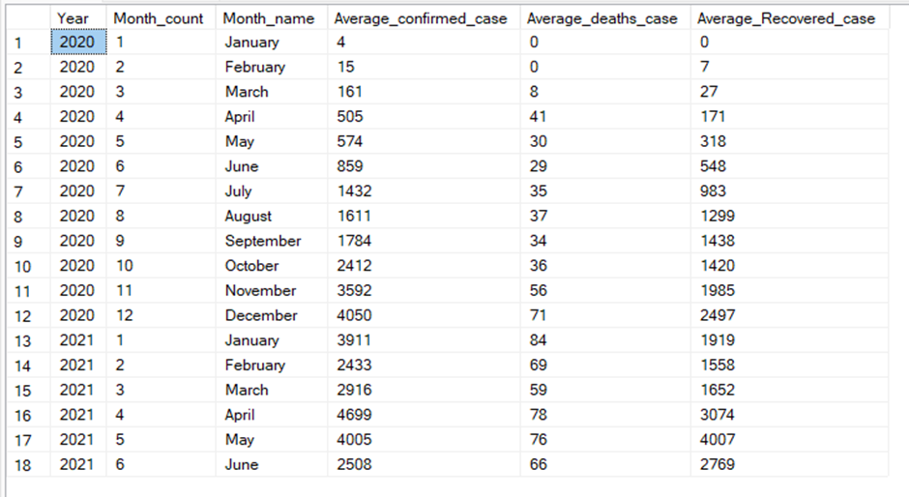
Q6. Find monthly average for confirmed, deaths, recovered
SELECT DATEPART(YEAR,Date) AS Year,
DATEPART(MONTH,Date) AS Month_count, DATENAME(MONTH,Date) AS Month_name,
AVG(Confirmed) AS Average_confirmed_case,
AVG(Deaths) AS Average_deaths_case,
AVG(Recovered) AS Average_Recovered_case FROM [Corona Virus Dataset]
GROUP BY DATEPART(YEAR,Date) , DATEPART(MONTH,Date),
DATENAME(MONTH,Date)
ORDER BY Year ,Month_count;

Slide 13
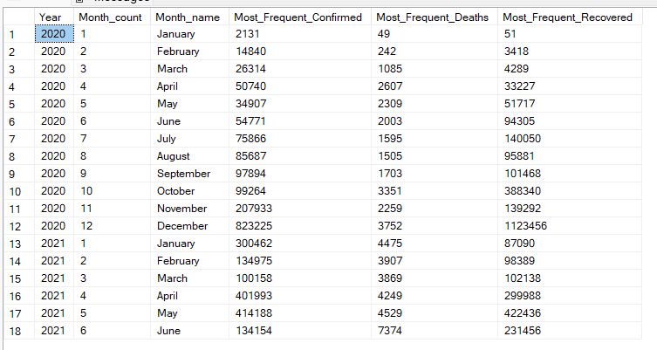
Q7. Find most frequent value for confirmed, deaths, recovered each month
WITH CTE AS (
SELECT
DATEPART(YEAR,Date) AS Year,
DATEPART(MONTH,Date) AS Month_count,
DATENAME(MONTH,Date) AS Month_name,
Confirmed, Deaths, Recovered,
RANK() OVER (PARTITION BY DATEPART(YEAR,Date), DATEPART(MONTH,Date), DATEPART(MONTH,Date) ORDER BY Confirmed DESC) AS RANK_Confirmed,
RANK() OVER (PARTITION BY DATEPART(YEAR,Date), DATEPART(MONTH,Date), DATEPART(MONTH,Date) ORDER BY Deaths DESC) AS RANK_Deaths,
RANK() OVER (PARTITION BY DATEPART(YEAR,Date), DATEPART(MONTH,Date), DATEPART(MONTH,Date) ORDER BY Recovered DESC) AS RANK_Recovered
FROM [Corona Virus Dataset]
)
SELECT
Year, Month_count, Month_name,
MAX(CASE WHEN RANK_Confirmed = 1 THEN Confirmed END) AS Most_Frequent_Confirmed,
MAX(CASE WHEN RANK_Deaths = 1 THEN Deaths END) AS Most_Frequent_Deaths,
MAX(CASE WHEN RANK_Recovered = 1 THEN Recovered END) AS Most_Frequent_Recovered
FROM CTE
GROUP BY Year, Month_count, Month_name
ORDER BY Year, Month_count, Month_name;

Slide 14
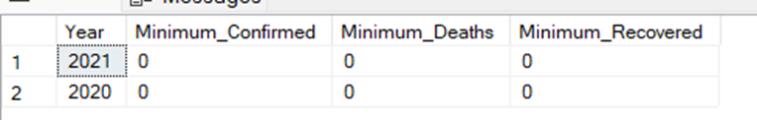
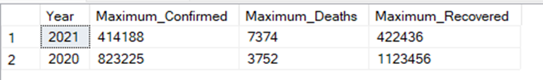
Q8. Find minimum values for confirmed, deaths, recovered per year
Q9. Find maximum values of confirmed, deaths, recovered per year
SELECT DATEPART(YEAR,Date) AS Year,
MIN(Confirmed) AS Minimum_Confirmed,
MIN(Deaths) AS Minimum_Deaths,
MIN(Recovered) AS Minimum_Recovered
FROM [Corona Virus Dataset]
GROUP BY DATEPART(YEAR,Date)
SELECT DATEPART(YEAR,Date) AS Year,
MAX(Confirmed) AS Maximum_Confirmed,
MAX(Deaths) AS Maximum_Deaths,
MAX(Recovered) AS Maximum_Recovered
FROM [Corona Virus Dataset]
GROUP BY DATEPART(YEAR,Date)

Slide 15
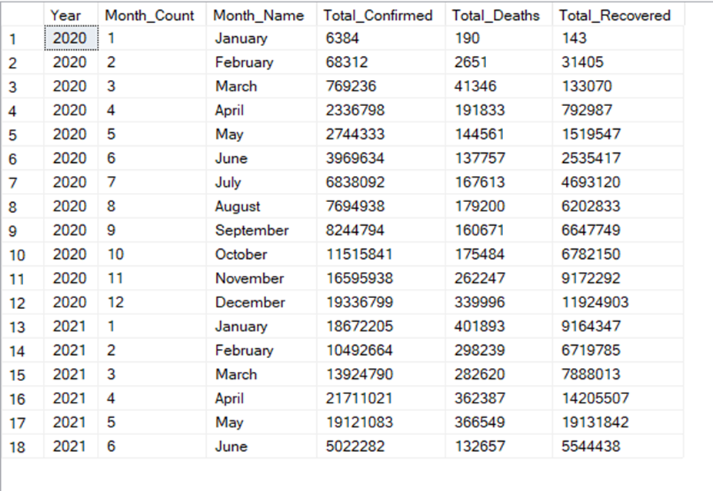
Q10. The total number of case of confirmed, deaths, recovered each month
SELECT DATEPART(YEAR,Date) AS Year,
DATEPART(MONTH,Date) AS Month_Count,
DATENAME(MONTH,Date) AS Month_Name,
SUM(Confirmed) AS Total_Confirmed,
SUM(Deaths) AS Total_Deaths,
SUM(Recovered) AS Total_Recovered
FROM [Corona Virus Dataset]
GROUP BY DATEPART(YEAR,Date),DATEPART(MONTH,Date),DATENAME(MONTH,Date)
ORDER BY Year,Month_Count

Slide 16

Q11. Check how corona virus spread out with respect to confirmed case
SELECT SUM(Confirmed) AS Total_Confirmed,
ROUND(AVG(Confirmed), 3) AS Avearge_Confirmed,
ROUND(VAR(Confirmed), 3) AS Variance_Confirmed,
ROUND(STDEV(Confirmed), 3) AS STDEV_Confirmed
FROM [Corona Virus Dataset]

Slide 17
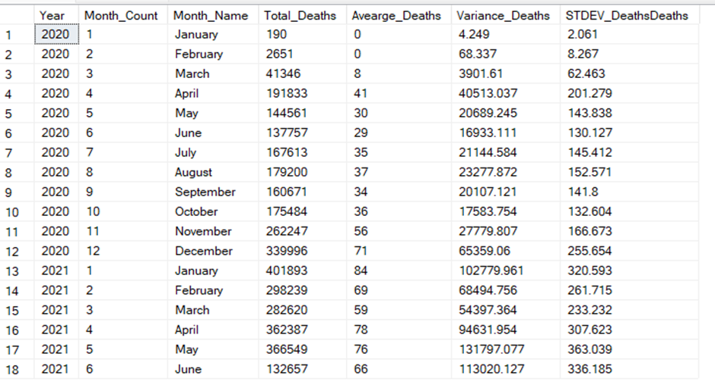
Q12. Check how corona virus spread out with respect to death case per month
SELECT DATEPART(YEAR,Date) AS Year,
DATEPART(MONTH,Date) AS Month_Count,
DATENAME(MONTH,Date) AS Month_Name,
SUM(Deaths) AS Total_Deaths,
ROUND(AVG(Deaths), 3) AS Avearge_Deaths,
ROUND(VAR(Deaths), 3) AS Variance_Deaths,
ROUND(STDEV(Deaths), 3) AS STDEV_DeathsDeaths
FROM [Corona Virus Dataset]
GROUP BY DATEPART(YEAR,Date),DATEPART(MONTH,Date),DATENAME(MONTH,Date)
ORDER BY Year,Month_Count

Slide 18


Q13. Check how corona virus spread out with respect to recovered case
Q14. Find Country having highest number of the Confirmed case
WITH CTE AS (SELECT Country_Region AS Country,
SUM(Confirmed) AS Total_Confirmed FROM [Corona Virus Dataset]
GROUP BY Country_Region),
Max_Confirmed AS (SELECT MAX(Total_Confirmed) AS Max_Total_Confirmed FROM CTE)
SELECT CTE.Country, CTE.Total_Confirmed FROM CTE
JOIN Max_Confirmed AS mc ON CTE.Total_Confirmed = mc.Max_Total_Confirmed
ORDER BY CTE.Country
SELECT SUM(Recovered) AS Total_Recovered,
ROUND(AVG(Recovered), 3) AS Avearge_Recovered,
ROUND(VAR(Recovered), 3) AS Variance_Recovered,
ROUND(STDEV(Recovered), 3) AS STDEV_Recovered
FROM [Corona Virus Dataset]

Slide 19
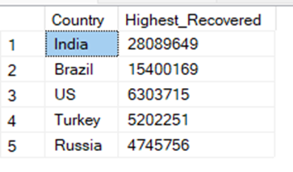
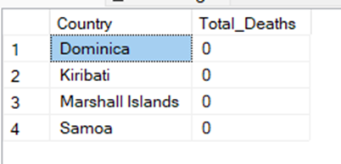
Q15. Find Country having lowest number of the death case
Q16. Find top 5 countries having highest recovered case
WITH CTE AS (SELECT Country_Region AS Country,
SUM(Deaths) AS Total_Deaths FROM [Corona Virus Dataset]
GROUP BY Country_Region),
Min_Deaths AS (SELECT MIN(Total_Deaths) AS Min_Total_Deaths FROM CTE)
SELECT CTE.Country, CTE.Total_Deaths FROM CTE
JOIN Min_Deaths AS md ON CTE.Total_Deaths = md.Min_Total_Deaths
ORDER BY CTE.Country
SELECT TOP 5 Country_Region AS Country,
SUM(Recovered) AS Highest_Recovered
FROM [Corona Virus Dataset]
GROUP BY Country_Region
ORDER BY Highest_Recovered DESC

Slide 20
04
INSIGHTS

Slide 21


The dataset contains data records from 22 January 2020 to 13 June 2021.
The Total Confirmed Cases in 2020 and 2021 were 8.9 million and 8 million respectively.
The Total Death Cases in 2020 and 2021 were 0.19 million and 0.18 million respectively.
The Total Recovered Cases in 2020 and 2021 were 6.27 million and 5.04 million respectively.
2020 had more Confirmed cases and Recovered cases while 2021 recorded more Death cases.
April 2021 month had the highest Confirmed cases and January 2020 had the lowest Confirmed cases.
January 2021 month had the highest Death cases and January 2020 had the lowest Death cases.
May 2021 month had the highest Recovered cases and January 2020 had the lowest Recovered cases.

Slide 22


US was the country with the highest number of Confirmed cases with 33.5 million people affected by the virus.
Dominica, Kiribati, Marshall Islands and Samoa were the countries with the lowest number of Death cases with no deaths at all.
India, Brazil, United States, Turkey, and Russia were the countries with the highest number of people recovering from Corona Virus.
Our deep dive into the coronavirus dataset paints a stark picture of COVID-19's sweeping impact. With a staggering 169 million confirmed cases, we're seeing the true global reach of this pandemic. The numbers tell a complex story: an average of 2,156 cases per record, but with wild swings that show how unevenly the virus has spread and how it surges unpredictably.
These insights aren't just statistics – they're a call to action. They underscore why we need to stay vigilant, why our responses need to be nimble, and why we've got to be smart about where we focus our efforts. By really grasping these patterns, we're not just fighting this pandemic; we're gearing up to face whatever health challenges come our way next. It's about building a healthcare system that can roll with the punches and come out stronger.

Slide 23


THANK YOU
DO YOU HAVE ANY QUESTIONS?
Mail me at:
adityasatheesan22@gmail.com
CREDITS: This presentation template was created by Slidesgo, and includes icons by Flaticon and infographics & images by Freepik

